Slide 1
Superstore Sales & Profit Analysis with Distribution Optimization
Tableau Project
By- SUPRITH S

Slide 2
Project Objective
This project analyzes Superstore sales data using Tableau to identify trends, patterns, and inefficiencies in business performance. The focus is on understanding sales, profit, and regional performance to improve decision-making.
Analyze sales and profit performance
Identify loss-making areas
Improve business efficiency using insights

Slide 3
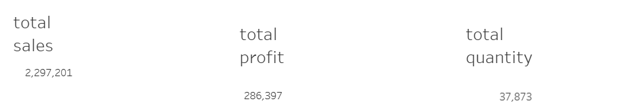
Key KPIs
Total Sales: 2.29 Million
Total Profit: 286K
Total Quantity: 37K+
Overall business is profitable
“The business has strong overall performance with over 2.2 million in sales and 286K profit.”

Slide 4
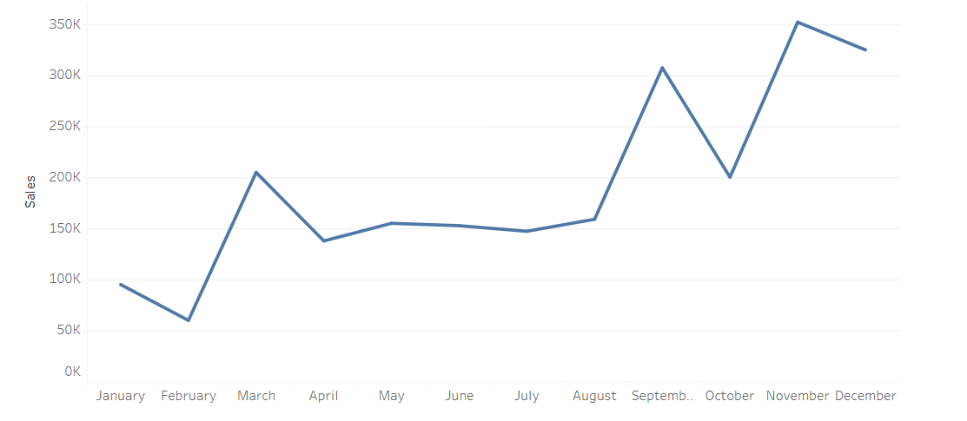
Monthly Sales Trend
“Sales increase throughout the year, peaking in November and December, indicating seasonal demand.”

Slide 5
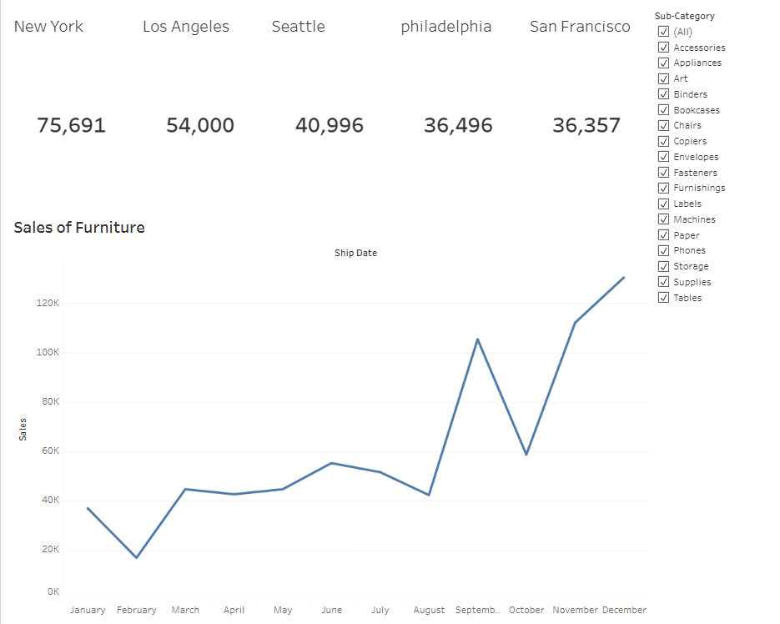
Sales of Furniture

Slide 6
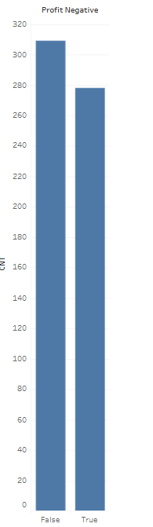
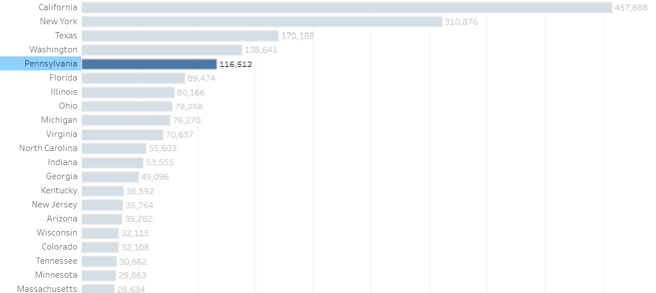
Profit By State
Pennsylvania is one of the superstore's biggest market by sales
“California and New York lead in sales, while Pennsylvania also contributes significantly.” “Despite high sales, Pennsylvania shows negative profit, which is a major concern.”

Slide 7
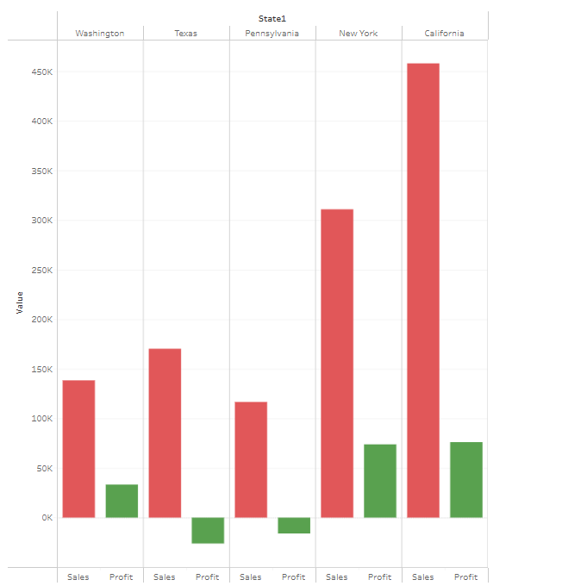
Profit By State
Positive profits in Washington, California, but a similar story in Texas
“New York leads in city-level sales, followed by Los Angeles and Philadelphia.”

Slide 8
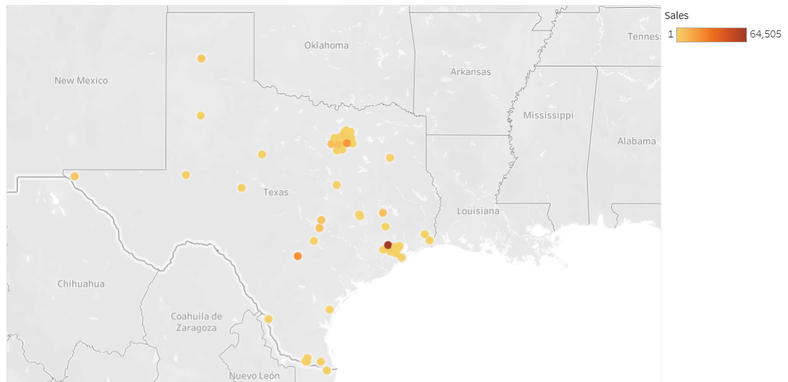
Distribution centre near Philadelphia
spread of sales in Texas may lessen the impact of distribution center
“A distribution center near Philadelphia will reduce logistics costs, improve delivery efficiency, and convert a high-sales but loss-making region into a profitable one.”

Slide 9
Key Findings from Analysis
Total sales are high (~2.29M) indicating strong business performance
Sales increase towards year-end, showing seasonal demand
Top performing states: California, New York, Texas
Pennsylvania has high sales but negative profit (major issue)
High number of loss-making orders in Pennsylvania
Overall profit is positive (~286K) but not consistent across regions
Furniture category is unprofitable
Tables and Bookcases are major loss-making sub-categories
Technology category generates highest profit
High cost of sales and shipping affecting profitability

Slide 10
Recommendations
Build a distribution center near Philadelphia
Reduce shipping and transportation costs
Improve delivery time and operational efficiency
Optimize supply chain and inventory management
Focus more on profitable categories (Technology)
Reduce or improve loss-making products (Tables, Bookcases)
Implement better pricing and discount strategies
Use high-performing regions as benchmarks for efficiency

Slide 11
Conclusion
Business is performing well in sales but has inefficiencies
Profitability issues are mainly due to high logistics and operational costs
Pennsylvania is a high-demand but loss-making region
The problem is not low sales, but poor cost management
A distribution center near Philadelphia can significantly improve profit
Data-driven decisions can help optimize overall business performance

Slide 12
- THE END -

